Slide 1
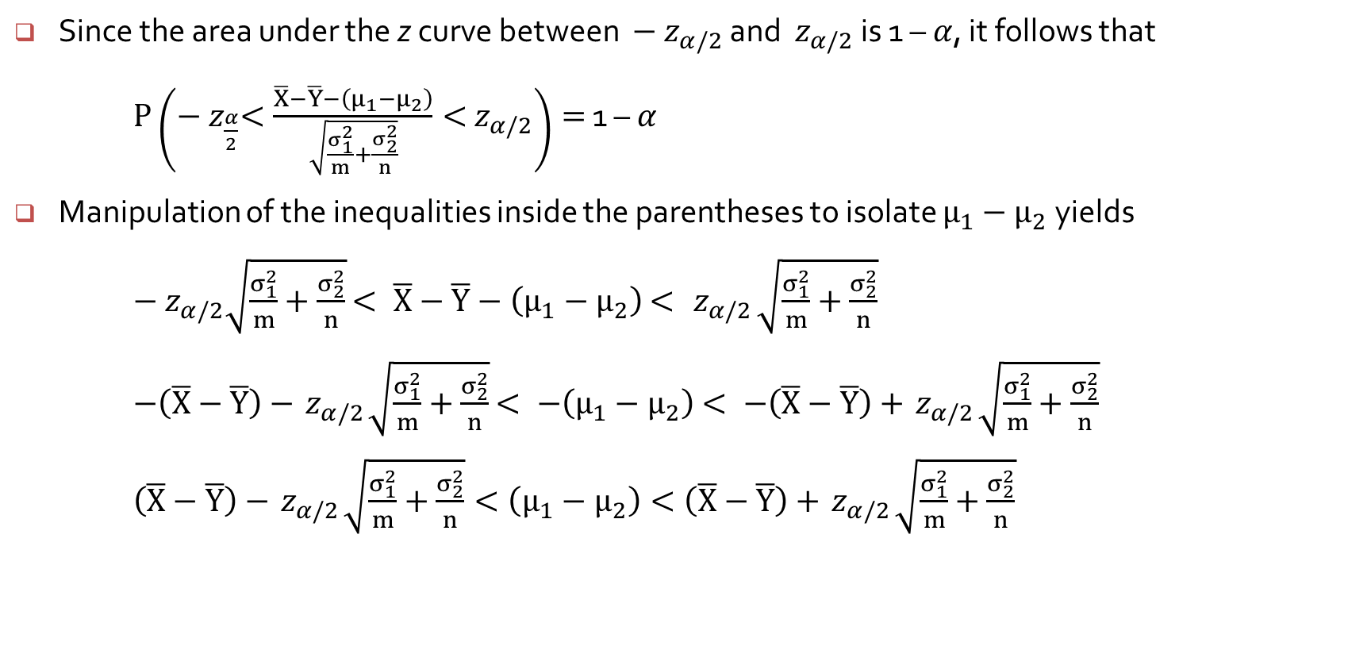
Confidence Intervals for $μ_{1}−μ_{2}$
Since the area under the z curve between $−{ z}_{α/2}$ and ${ z}_{α/2}$ is 1 – $α$, it follows that
$P\left(−{ z}_{\frac{α}{2}}<\frac{\overline{X}−\overline{Y}−\left(μ_{1}−μ_{2}\right)}{\sqrt{\frac{σ_{1}^{2}}{m}+\frac{σ_{2}^{2}}{n}}}<{ z}_{α/2}\right)=$ 1 – $α$
Manipulation of the inequalities inside the parentheses to isolate $μ_{1}−μ_{2}$ yields $−{ z}_{α/2}\sqrt{\frac{σ_{1}^{2}}{m}+\frac{σ_{2}^{2}}{n}}$ $< \overline{X}−\overline{Y}−\left(μ_{1}−μ_{2}\right)$ $< { z}_{α/2}\sqrt{\frac{σ_{1}^{2}}{m}+\frac{σ_{2}^{2}}{n}}$
$−\left(\overline{X}−\overline{Y}\right)−{ z}_{α/2}\sqrt{\frac{σ_{1}^{2}}{m}+\frac{σ_{2}^{2}}{n}}$ $< −\left(μ_{1}−μ_{2}\right)$ $< −\left(\overline{X}−\overline{Y}\right)+{ z}_{α/2}\sqrt{\frac{σ_{1}^{2}}{m}+\frac{σ_{2}^{2}}{n}}$
$\left(\overline{X}−\overline{Y}\right)−{ z}_{α/2}\sqrt{\frac{σ_{1}^{2}}{m}+\frac{σ_{2}^{2}}{n}}<\left(μ_{1}−μ_{2}\right)<\left(\overline{X}−\overline{Y}\right)+{ z}_{α/2}\sqrt{\frac{σ_{1}^{2}}{m}+\frac{σ_{2}^{2}}{n}}$

Slide 2
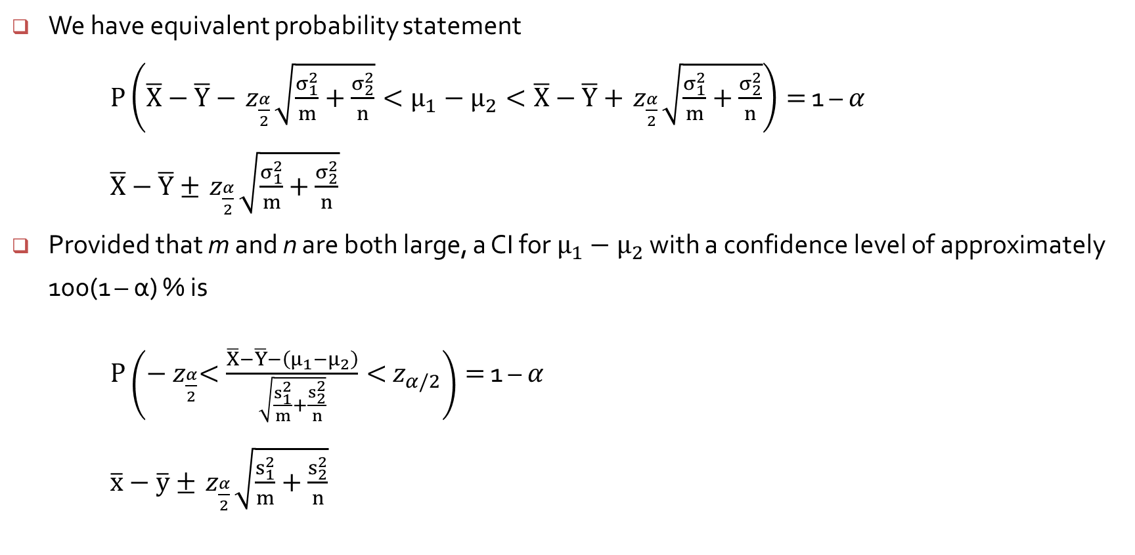
Confidence Intervals for $μ_{1}−μ_{2}$
We have equivalent probability statement
$P\left(\overline{X}−\overline{Y}−{ z}_{\frac{α}{2}}\sqrt{\frac{σ_{1}^{2}}{m}+\frac{σ_{2}^{2}}{n}}<μ_{1}−μ_{2}<\overline{X}−\overline{Y}+{ z}_{\frac{α}{2}}\sqrt{\frac{σ_{1}^{2}}{m}+\frac{σ_{2}^{2}}{n}}\right)=$ 1 – $α$
$\overline{X}−\overline{Y}±{ z}_{\frac{α}{2}}\sqrt{\frac{σ_{1}^{2}}{m}+\frac{σ_{2}^{2}}{n}}$
Provided that m and n are both large, a CI for $μ_{1}−μ_{2}$ with a confidence level of approximately 100(1 – α) % is
$P\left(−{ z}_{\frac{α}{2}}<\frac{\overline{X}−\overline{Y}−\left(μ_{1}−μ_{2}\right)}{\sqrt{\frac{s_{1}^{2}}{m}+\frac{s_{2}^{2}}{n}}}<{ z}_{α/2}\right)=$ 1 – $α$
$\overline{x}−\overline{y}±{ z}_{\frac{α}{2}}\sqrt{\frac{s_{1}^{2}}{m}+\frac{s_{2}^{2}}{n}}$

Slide 3
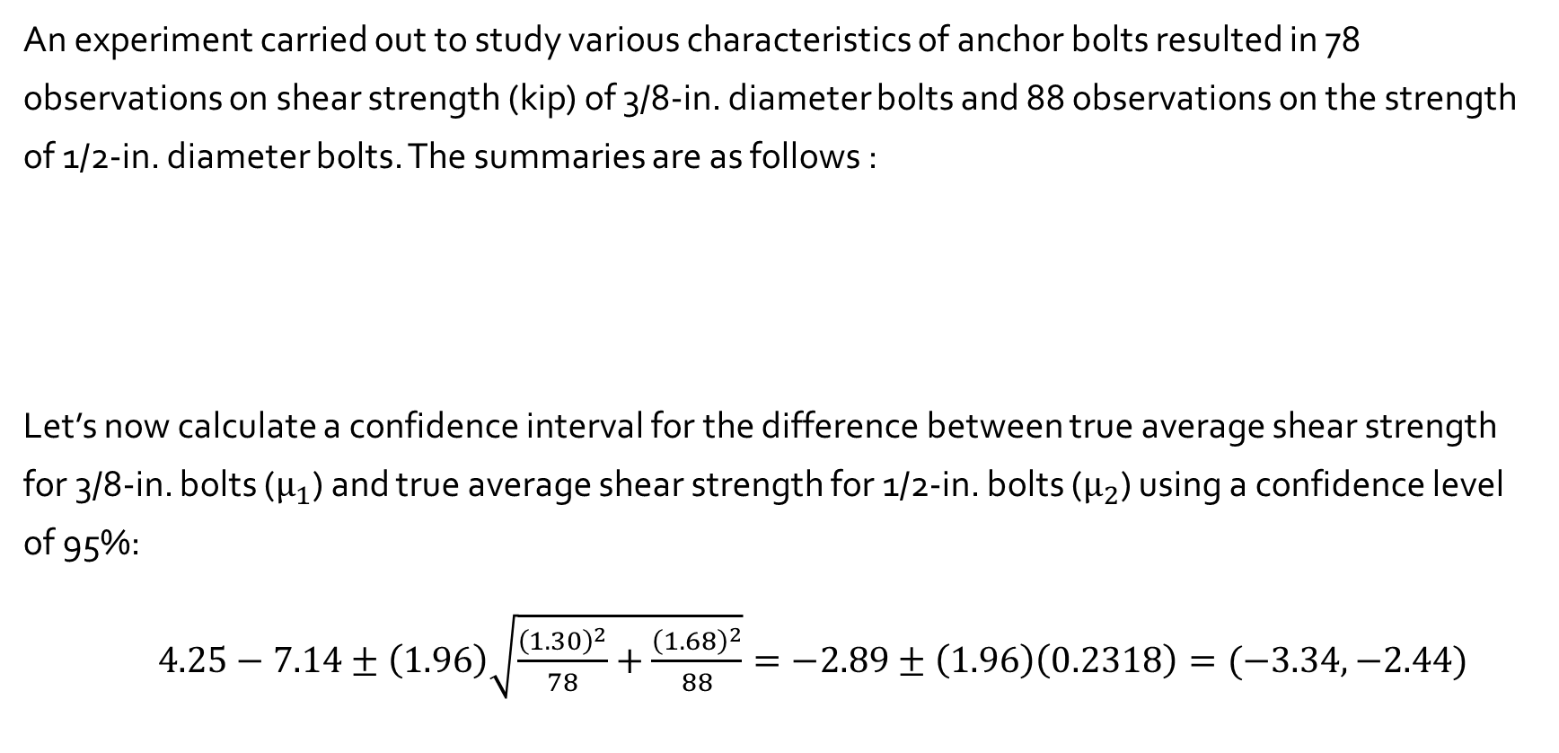
Example 9.5
An experiment carried out to study various characteristics of anchor bolts resulted in 78 observations on shear strength (kip) of 3/8-in. diameter bolts and 88 observations on the strength of 1/2-in. diameter bolts. The summaries are as follows :
Let’s now calculate a confidence interval for the difference between true average shear strength for 3/8-in. bolts ($μ_{1}$) and true average shear strength for 1/2-in. bolts ($μ_{2}$) using a confidence level of 95%:
$4.25−7.14±\left(1.96\right)\sqrt{\frac{{\left(1.30\right)}^{2}}{78}+\frac{{\left(1.68\right)}^{2}}{88}}=−2.89±\left(1.96\right)\left(0.2318\right)=(−3.34, −2.44)$
Variable | Sample Size | Sample Mean | Sample SD
diam 3/8 | 78 | 4.25 | 1.3
diam 1/2 | 88 | 7.14 | 1.68

Slide 4
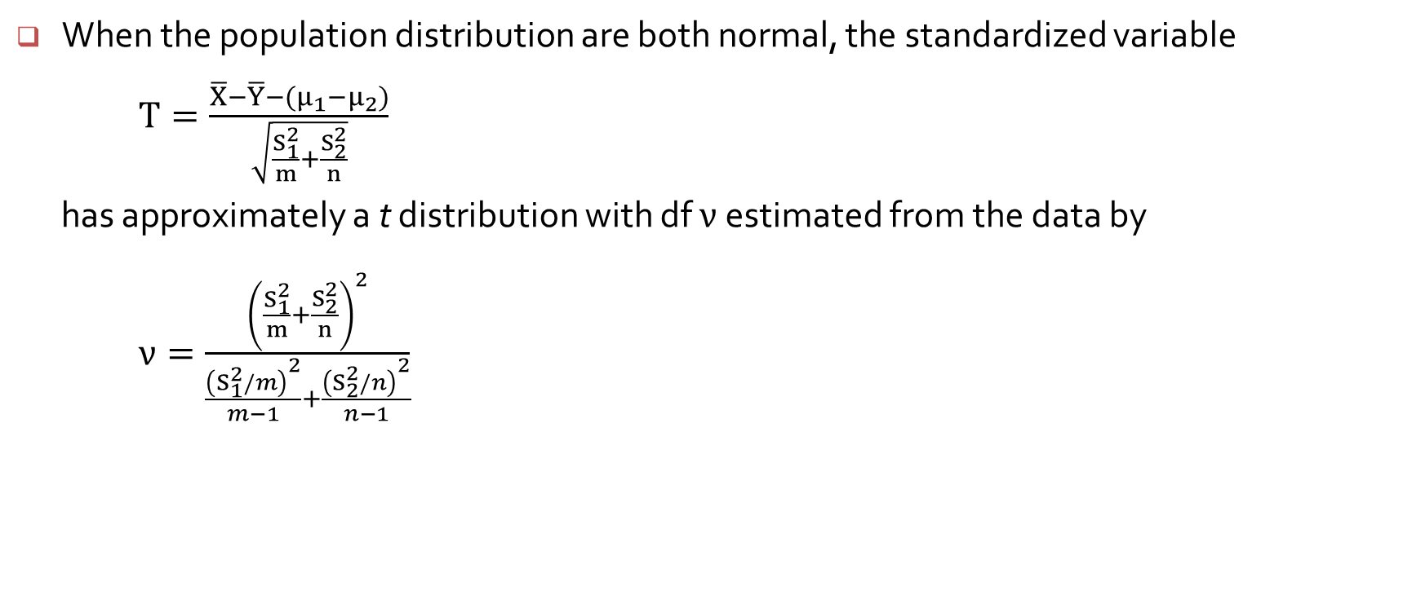
The Two-Sample t Test and Confidence Interval
When the population distribution are both normal, the standardized variable
$T=\frac{\overline{X}−\overline{Y}−(μ_{1}−μ_{2})}{\sqrt{\frac{S_{1}^{2}}{m}+\frac{S_{2}^{2}}{n}}}$
has approximately a t distribution with df $ν$estimated from the data by
$ν=\frac{{\left(\frac{S_{1}^{2}}{m}+\frac{S_{2}^{2}}{n}\right)}^{2}}{\frac{{\left(S_{1}^{2}/m\right)}^{2}}{m−1}+\frac{{\left(S_{2}^{2}/n\right)}^{2}}{n−1}}$

Slide 5
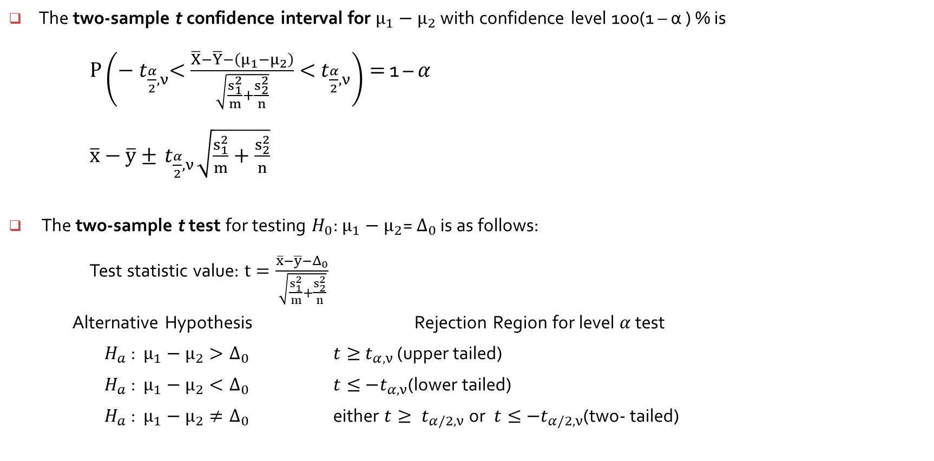
The Two-Sample t Test and Confidence Interval
The two-sample t confidence interval for $μ_{1}−μ_{2}$ with confidence level 100(1 – α ) % is
$P\left(−{ t}_{\frac{α}{2},ν}<\frac{\overline{X}−\overline{Y}−\left(μ_{1}−μ_{2}\right)}{\sqrt{\frac{s_{1}^{2}}{m}+\frac{s_{2}^{2}}{n}}}<{ t}_{\frac{α}{2},ν}\right)=$ 1 – $α$
$\overline{x}−\overline{y}±{ t}_{\frac{α}{2},ν}\sqrt{\frac{s_{1}^{2}}{m}+\frac{s_{2}^{2}}{n}}$
The two-sample t test for testing $H_{0}$: $μ_{1}−μ_{2}$= $Δ_{0}$ is as follows:
Test statistic value: $t=\frac{\overline{x}−\overline{y}−Δ_{0}}{\sqrt{\frac{s_{1}^{2}}{m}+\frac{s_{2}^{2}}{n}}}$
Alternative Hypothesis Rejection Region for level $α$ test
$H_{a}$ : $μ_{1}−μ_{2}>Δ_{0}$ $t≥{ t}_{α,ν}$ (upper tailed)
$H_{a}$ : $μ_{1}−μ_{2}<Δ_{0}$ $t≤{ −t}_{α,ν}$(lower tailed)
$H_{a}$ : $μ_{1}−μ_{2}≠Δ_{0}$ either $t≥{ t}_{α/2,ν} \text{or}$ $t≤{ −t}_{α/2,ν}$(two- tailed)

Slide 6
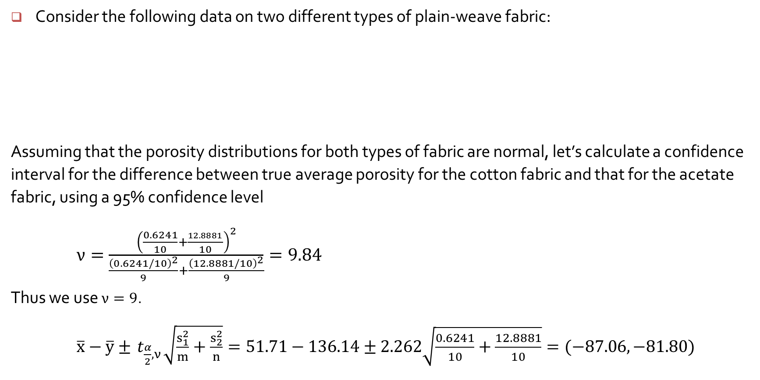
Example 9.6
Consider the following data on two different types of plain-weave fabric:
Assuming that the porosity distributions for both types of fabric are normal, let’s calculate a confidence interval for the difference between true average porosity for the cotton fabric and that for the acetate fabric, using a 95% confidence level
$ν=\frac{{\left(\frac{0.6241}{10}+\frac{12.8881}{10}\right)}^{2}}{\frac{{\left(0.6241/10\right)}^{2}}{9}+\frac{{\left(12.8881/10\right)}^{2}}{9}}=9.84$
Thus we use $ν=9$.
$\overline{x}−\overline{y}±{ t}_{\frac{α}{2},ν}\sqrt{\frac{s_{1}^{2}}{m}+\frac{s_{2}^{2}}{n}}=51.71−136.14±2.262\sqrt{\frac{0.6241}{10}+\frac{12.8881}{10}}=(−87.06, −81.80)$
Fabric Type | Sample Size | Sample Mean | Sample SD | Sample Variance
Cotton | 10 | 51.71 | 0.79 | 0.6241
Triacetate | 10 | 136.14 | 3.59 | 12.8881

